Slide 1
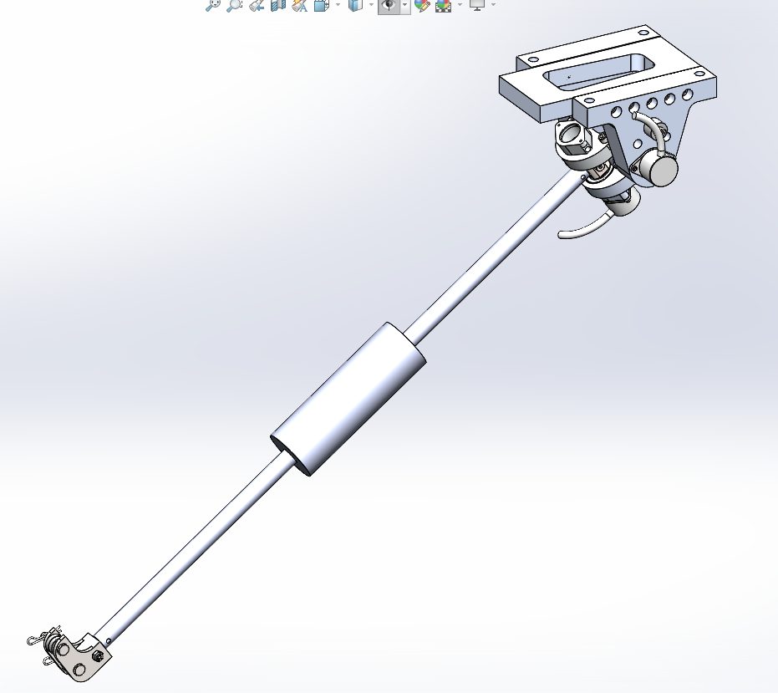
System Overview
2 Nested Axes
Renishaw RM22 13 bit encoders
Mass ~ 4.7 lbs
Inertia about the rotational axis reduced
Hollow carbon rod with piston seals on each end to keep airtight.
Polyethylene Pipe Insulation added to eliminate net moment on the boom arm.

Slide 2
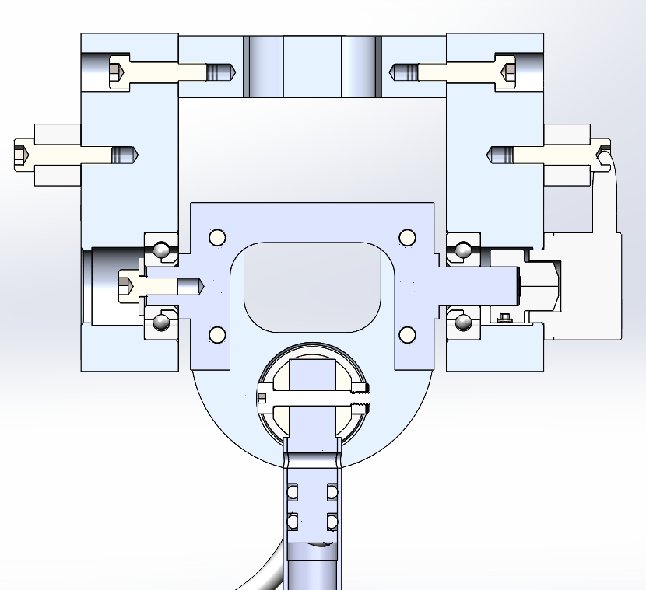
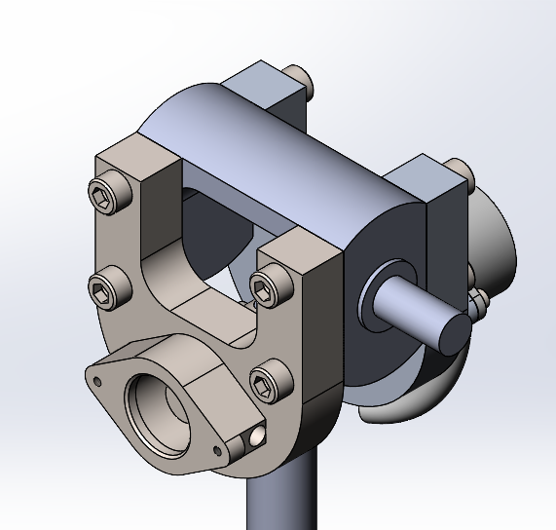
Elevation Pivot Cross Section
Mass reduced where possible.
Sensor mount remains on passive side. Will be used to implement quick release mechanism for tow testing.

Slide 3
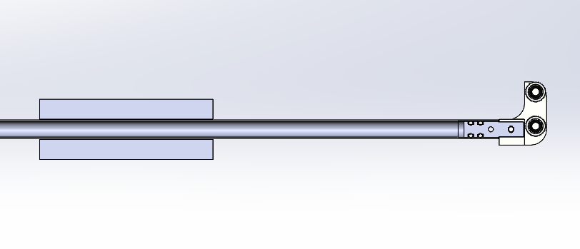
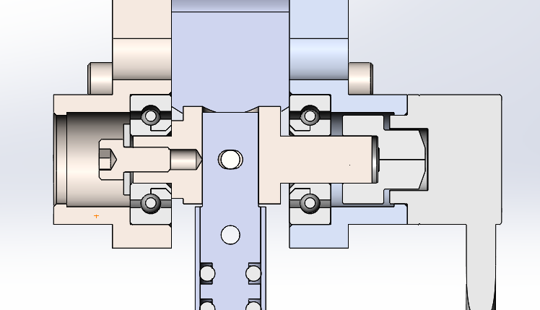
Azimuth Axis and Boom
Tether Arm is attached to the pivot using a 1/8” 316 shoulder bolt cross-drilled through the pivot and the arm.
Reliably and repeatably attach the arm and the pivot.
Similar method is used at the far end of the tether arm to attach the tether guide.
Piston seals present to keep carbon rod ID dry.
Tether guide implements 316 bearings to allow for reduced friction during tension measurements.

Slide 4
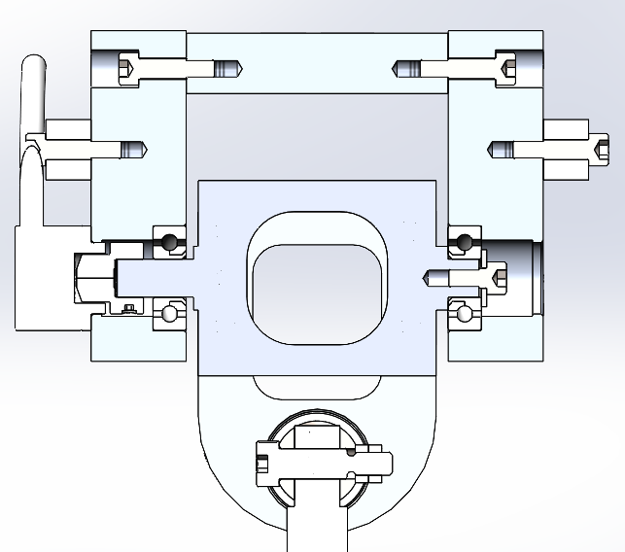
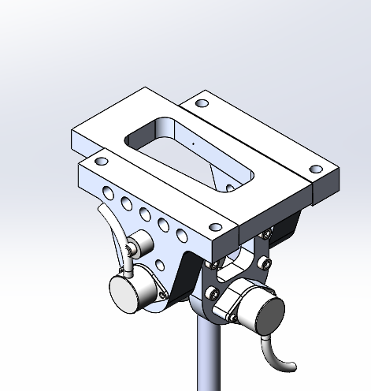
Static Structure
Anode
Anode attached to side of elevation axis support.
Main span hollowed out to allow passage of kite tether.
Large region in front of LAS static structure left for quick release design implantation for DOE tow testing.

